Slide 1


Android Lecture #
2week
Progress Bar &
ViewFlipper

Slide 2

Contents
What is progress bar?
How to use it?
Example
What is ViewFlipper?
How to use it?(Example)

Slide 3

Progress Bar

Slide 4

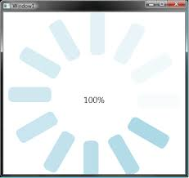

1. What is progress bar?

Slide 5
2. How to use it?
Insert at layout file

Slide 6

2. How to use it?

Slide 7
3. Example
SampleProgressBar

Slide 8
ViewFlipper

Slide 9
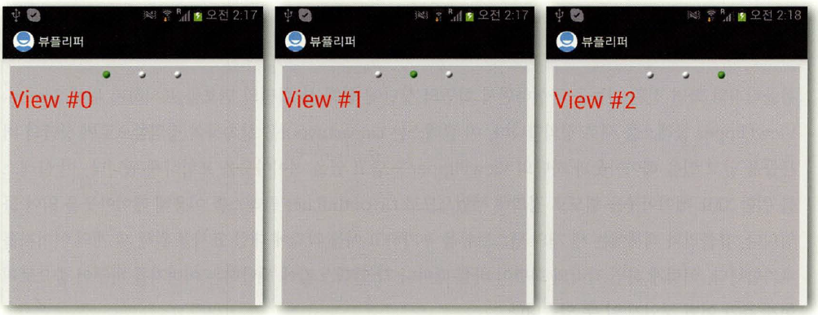
4. What is ViewFlipper?

Slide 10


* LayoutInflater

Slide 11
5. How to use it?
SampleViewFIipper

Slide 12
Thank you!

